Slide 1
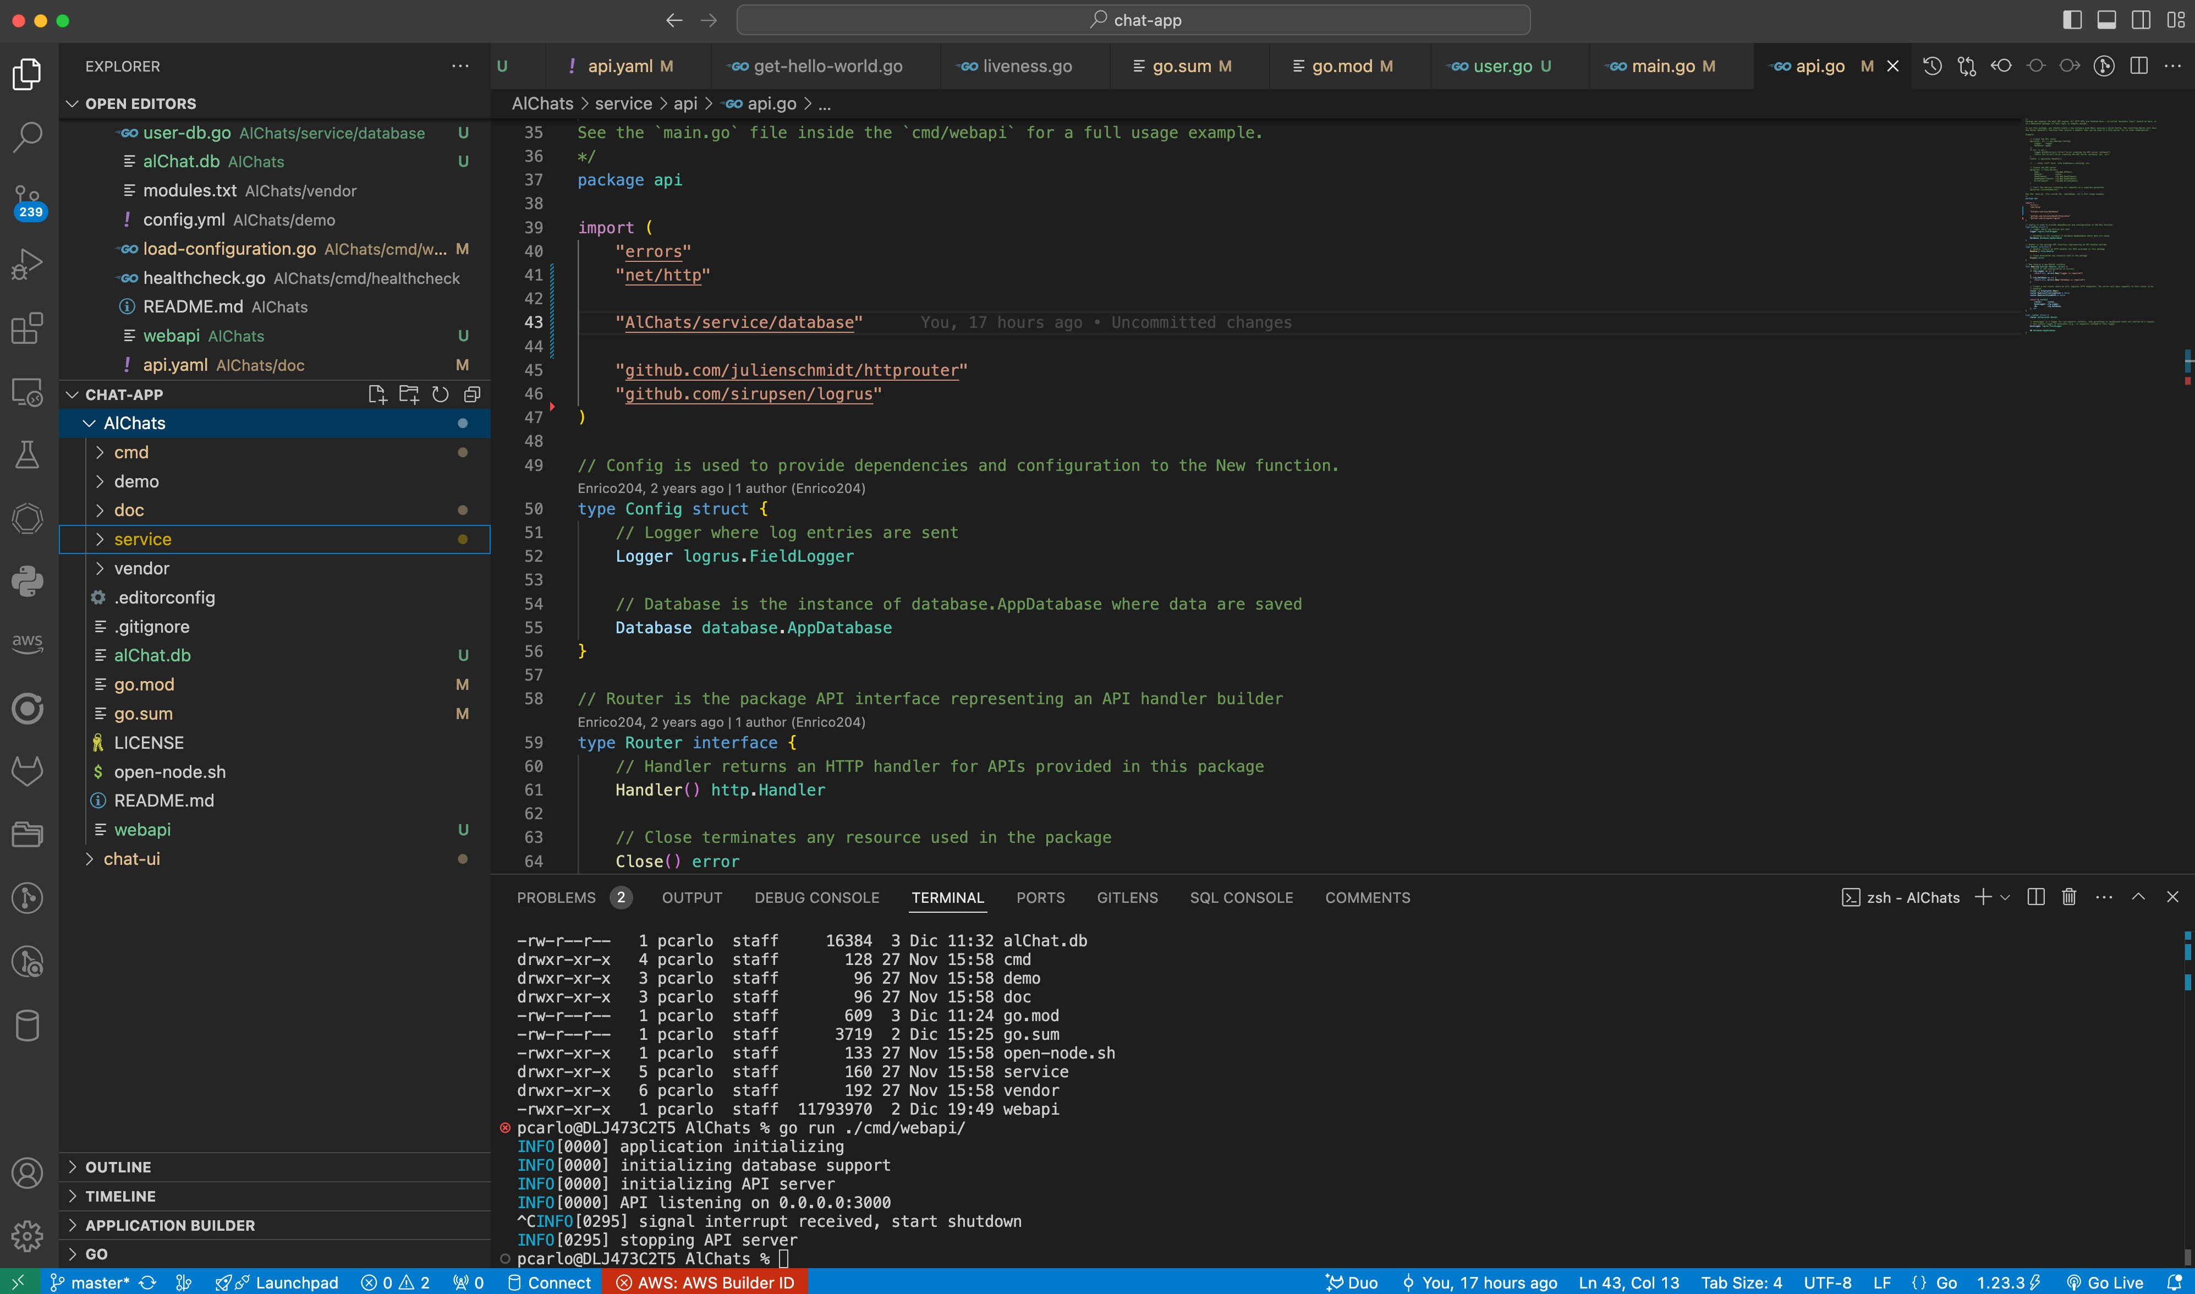
Come aggiungere un nuovo modello, le sue query Db e i sui endpoint http

Slide 2
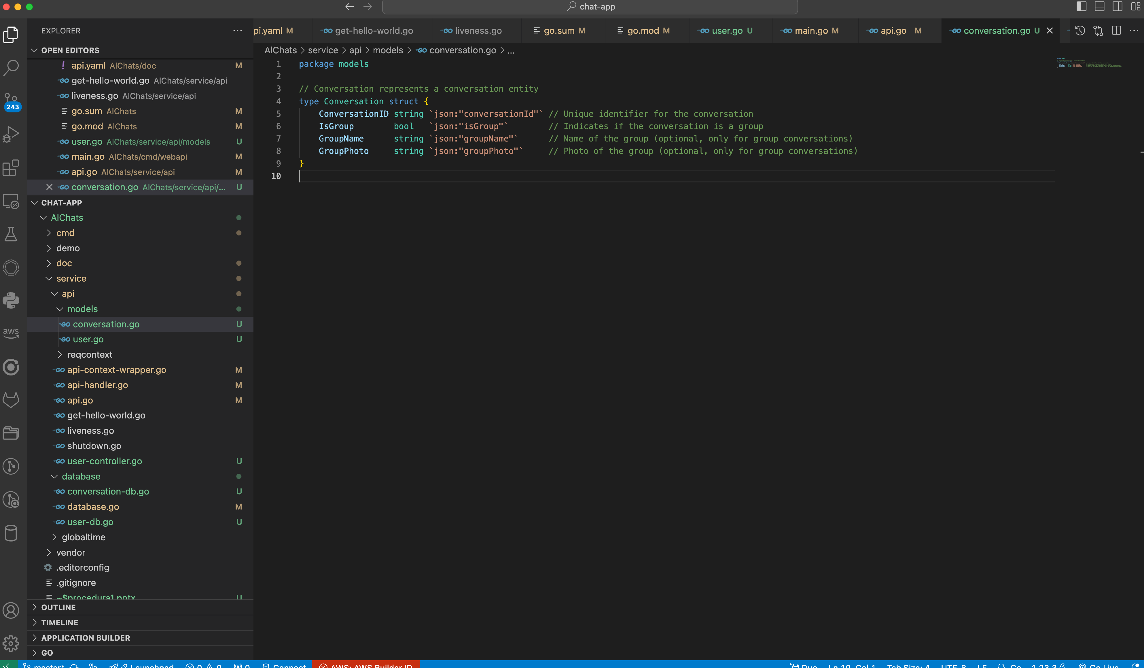
Create a Model Conversation

Slide 3
Design Database Tables for Conversation
user_table
conversation_table
ConversationID vs UserID
message_table

Slide 4
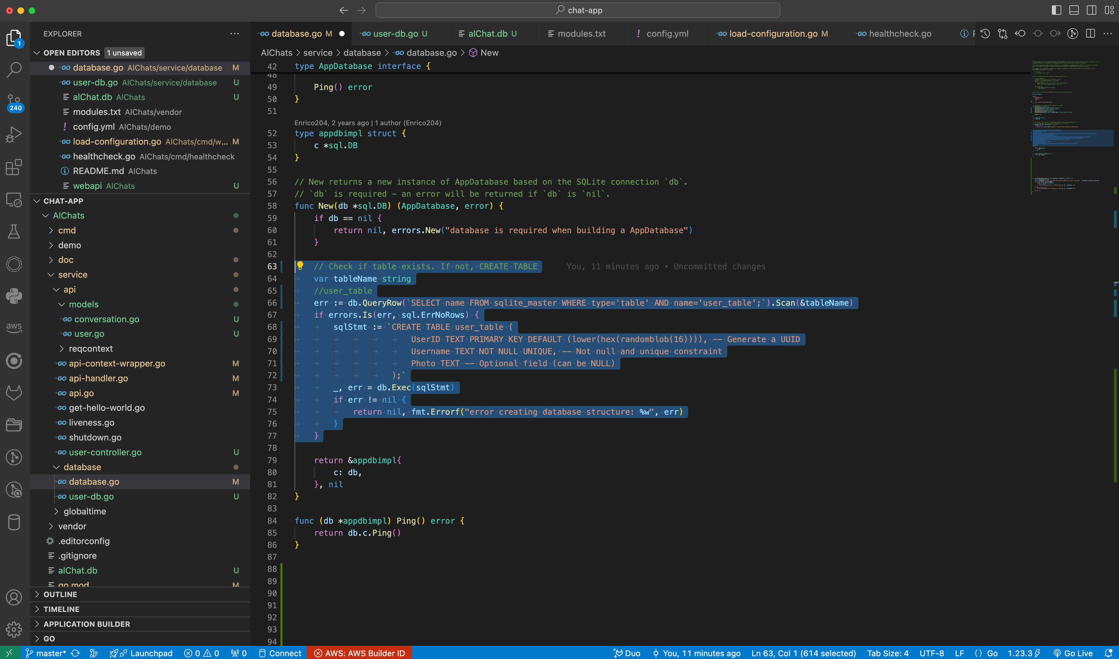
DDL and Initialization for Conversation
in questa sezione va
aggiunta la verifica per la nuova
tabella
Ma conviene usilizzare delle
fuzioni ausiliarie per gestire
molte tabelle
vediamo come nelle prossime
slides

Slide 5
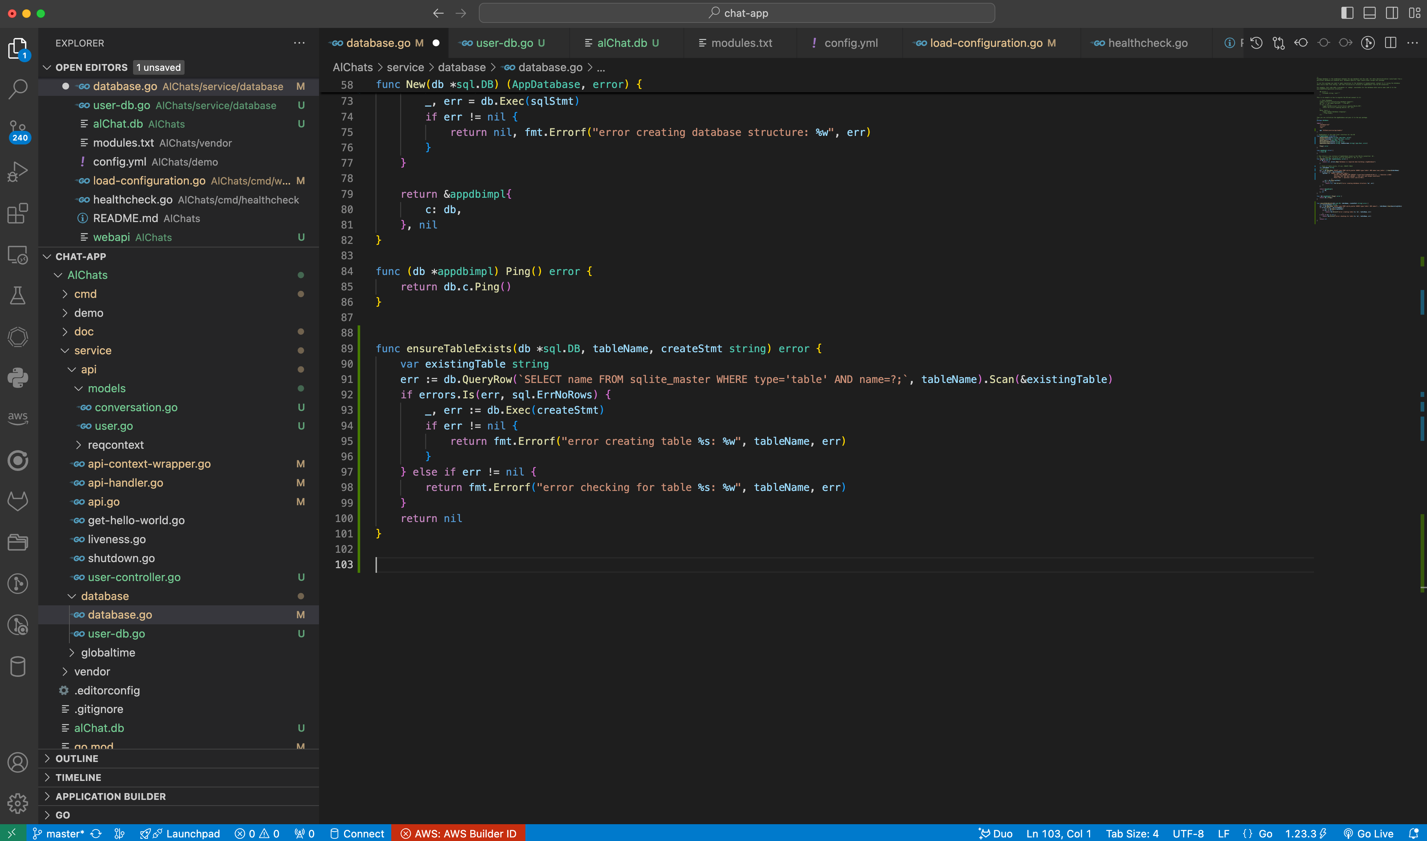
DDL and Initialization for Conversation
aggiungiamo la funzione
ensureTableExists
che verifica solo se
una tabella é già
eistente

Slide 6
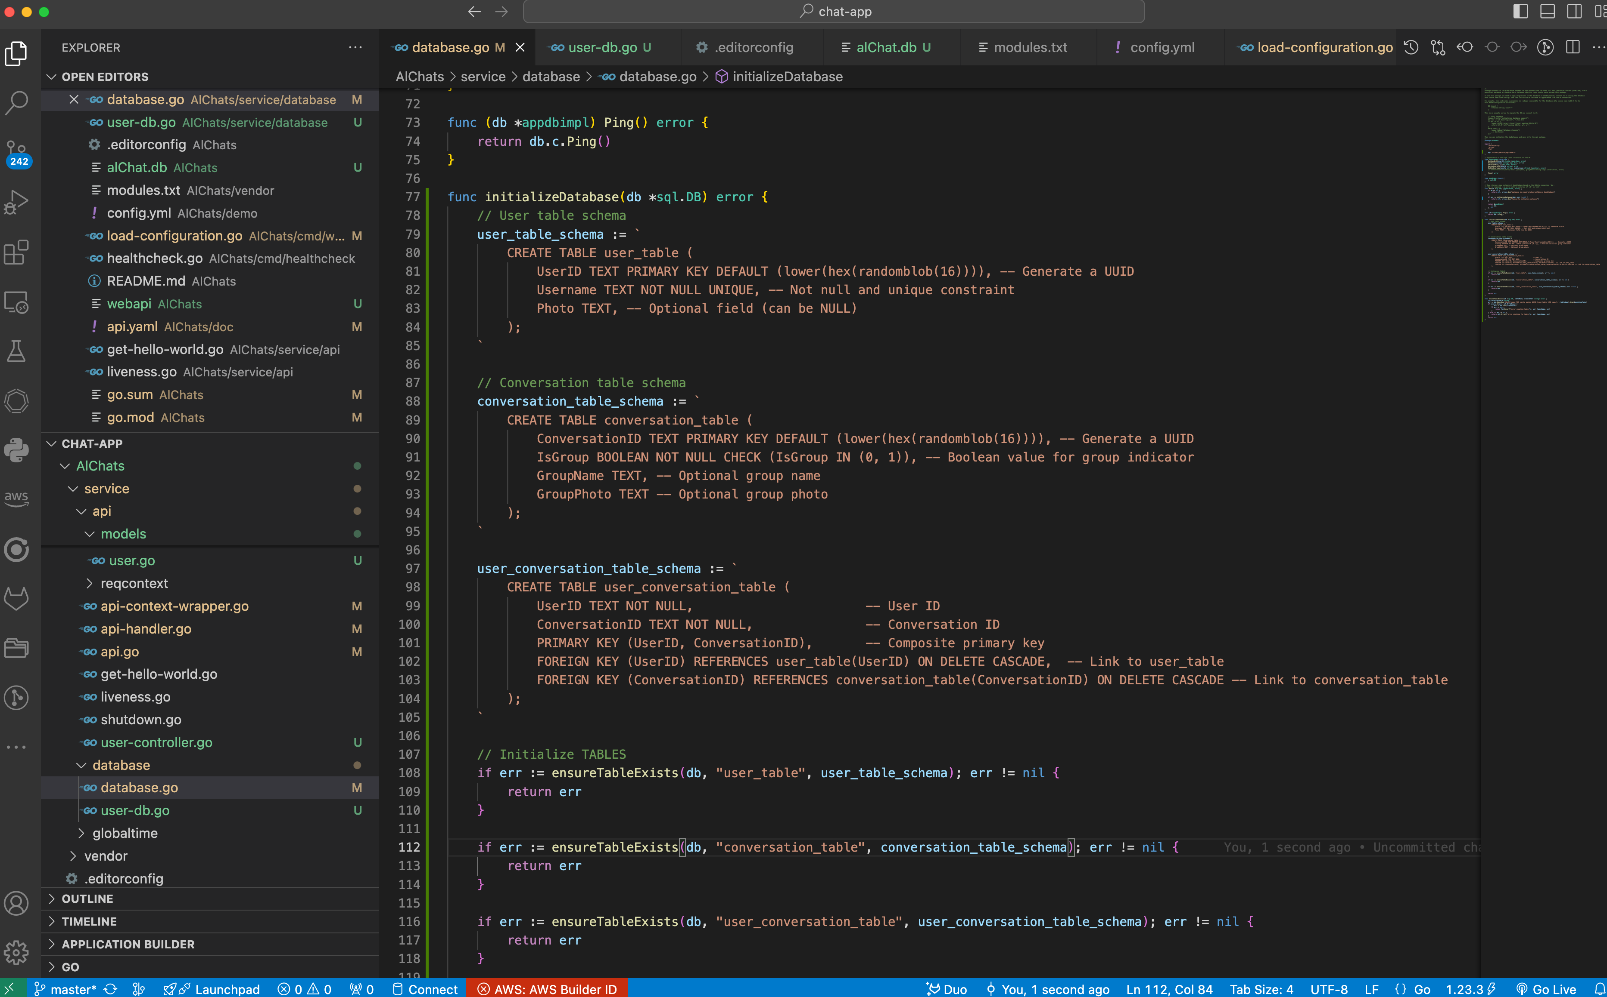
DDL and Initialization for Conversation
aggiungiamo la funzione
initializeDatabase
che crea le tabelle se non
esistono
aggiungo una tabella per testire
la relazione molti a molti
// User table schema
user_table_schema := `
CREATE TABLE user_table (
UserID TEXT PRIMARY KEY DEFAULT (lower(hex(randomblob(16)))), -- Generate a UUID
Username TEXT NOT NULL UNIQUE, -- Not null and unique constraint
Photo TEXT, -- Optional field (can be NULL)
);
`
// Conversation table schema
conversation_table_schema := `
CREATE TABLE conversation_table (
ConversationID TEXT PRIMARY KEY DEFAULT (lower(hex(randomblob(16)))), -- Generate a UUID
IsGroup BOOLEAN NOT NULL CHECK (IsGroup IN (0, 1)), -- Boolean value for group indicator
GroupName TEXT, -- Optional group name
GroupPhoto TEXT -- Optional group photo
);
`
user_conversation_table_schema := `
CREATE TABLE user_conversation_table (
UserID TEXT NOT NULL, -- User ID
ConversationID TEXT NOT NULL, -- Conversation ID
PRIMARY KEY (UserID, ConversationID), -- Composite primary key
FOREIGN KEY (UserID) REFERENCES user_table(UserID) ON DELETE CASCADE, -- Link to user_table
FOREIGN KEY (ConversationID) REFERENCES conversation_table(ConversationID) ON DELETE CASCADE -- Link to conversation_table
);
`

Slide 7
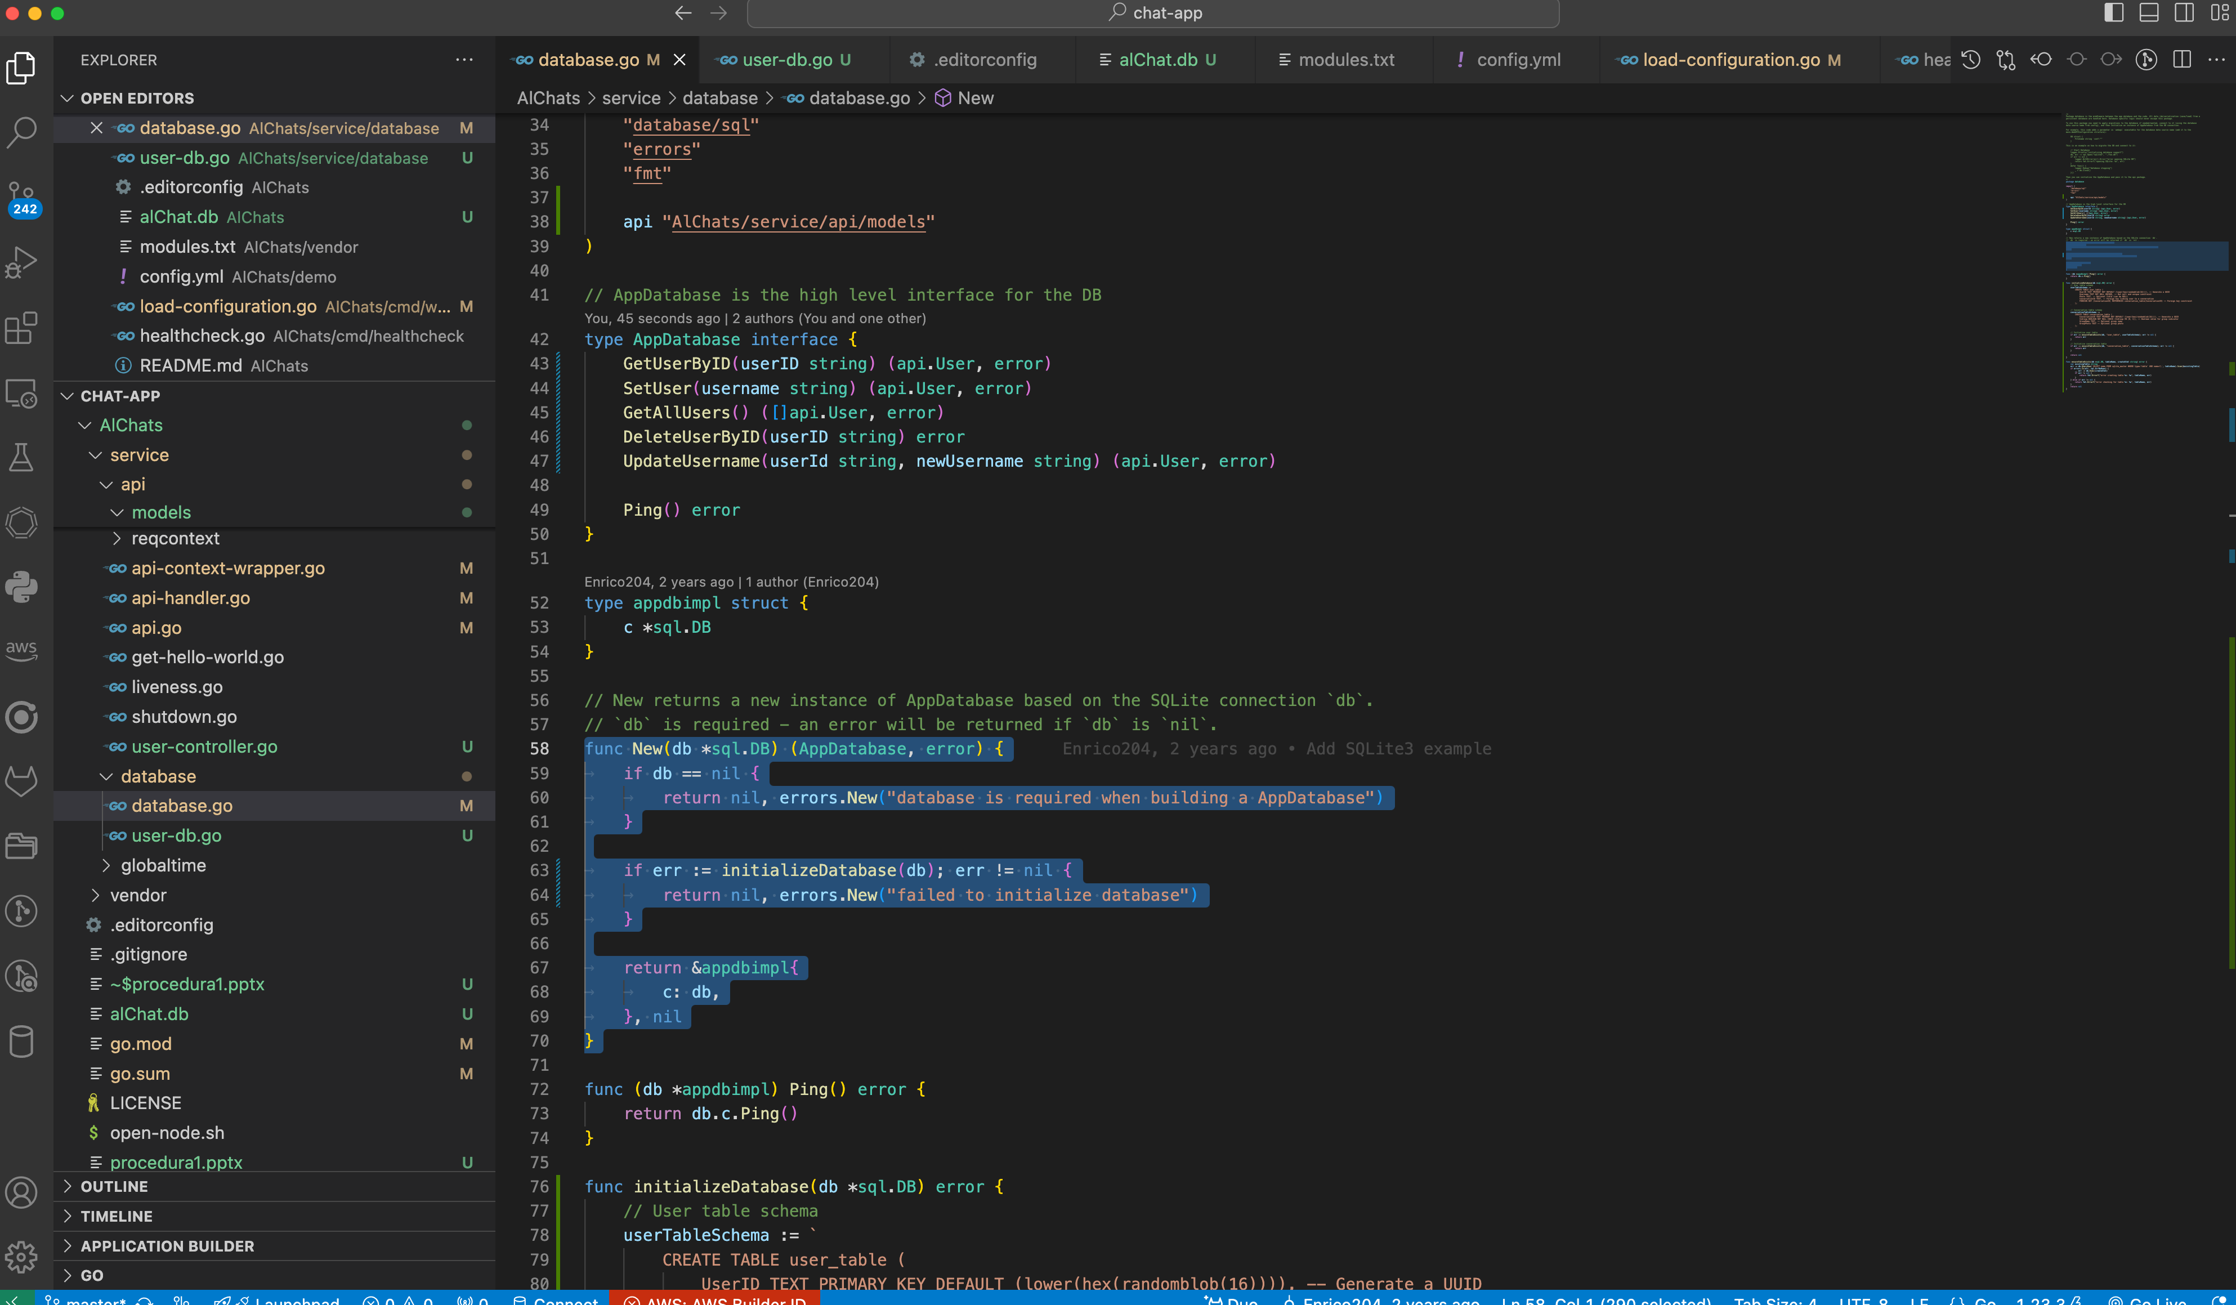
DDL and Initialization for Conversation
modifichiamo la funzione New
in modo da chiamare
le nostre funzioni
testiamo la nuova struttura

Slide 8
DDL and Initialization for Conversation
testiamo la nuova struttura
cancellazione db
pcarlo@DLJ473C2T5 chat-app % cd AlChats
pcarlo@DLJ473C2T5 AlChats % ls -al al*
-rw-r--r-- 1 pcarlo staff 16384 3 Dic 12:58 alChat.db
pcarlo@DLJ473C2T5 AlChats % rm alChat.db
pcarlo@DLJ473C2T5 AlChats % ls -al al*
zsh: no matches found: al*
pcarlo@DLJ473C2T5 AlChats %
avvio programma
pcarlo@DLJ473C2T5 AlChats % go run ./cmd/webapi/
INFO[0000] application initializing
INFO[0000] initializing database support
INFO[0000] initializing API server
INFO[0000] API listening on 0.0.0.0:3000
check database
pcarlo@DLJ473C2T5 AlChats % ls -al al*
-rw-r--r-- 1 pcarlo staff 24576 3 Dic 13:40 alChat.db
pcarlo@DLJ473C2T5 AlChats % sqlite3 alChat.db
SQLite version 3.43.2 2023-10-10 13:08:14
Enter ".help" for usage hints.
sqlite> SELECT name FROM sqlite_master WHERE type='table';
user_table
conversation_table
user_conversation_table
sqlite>

Slide 9
Creazione funzioni DB per Conversation
creazione
modello per conversation

Slide 10
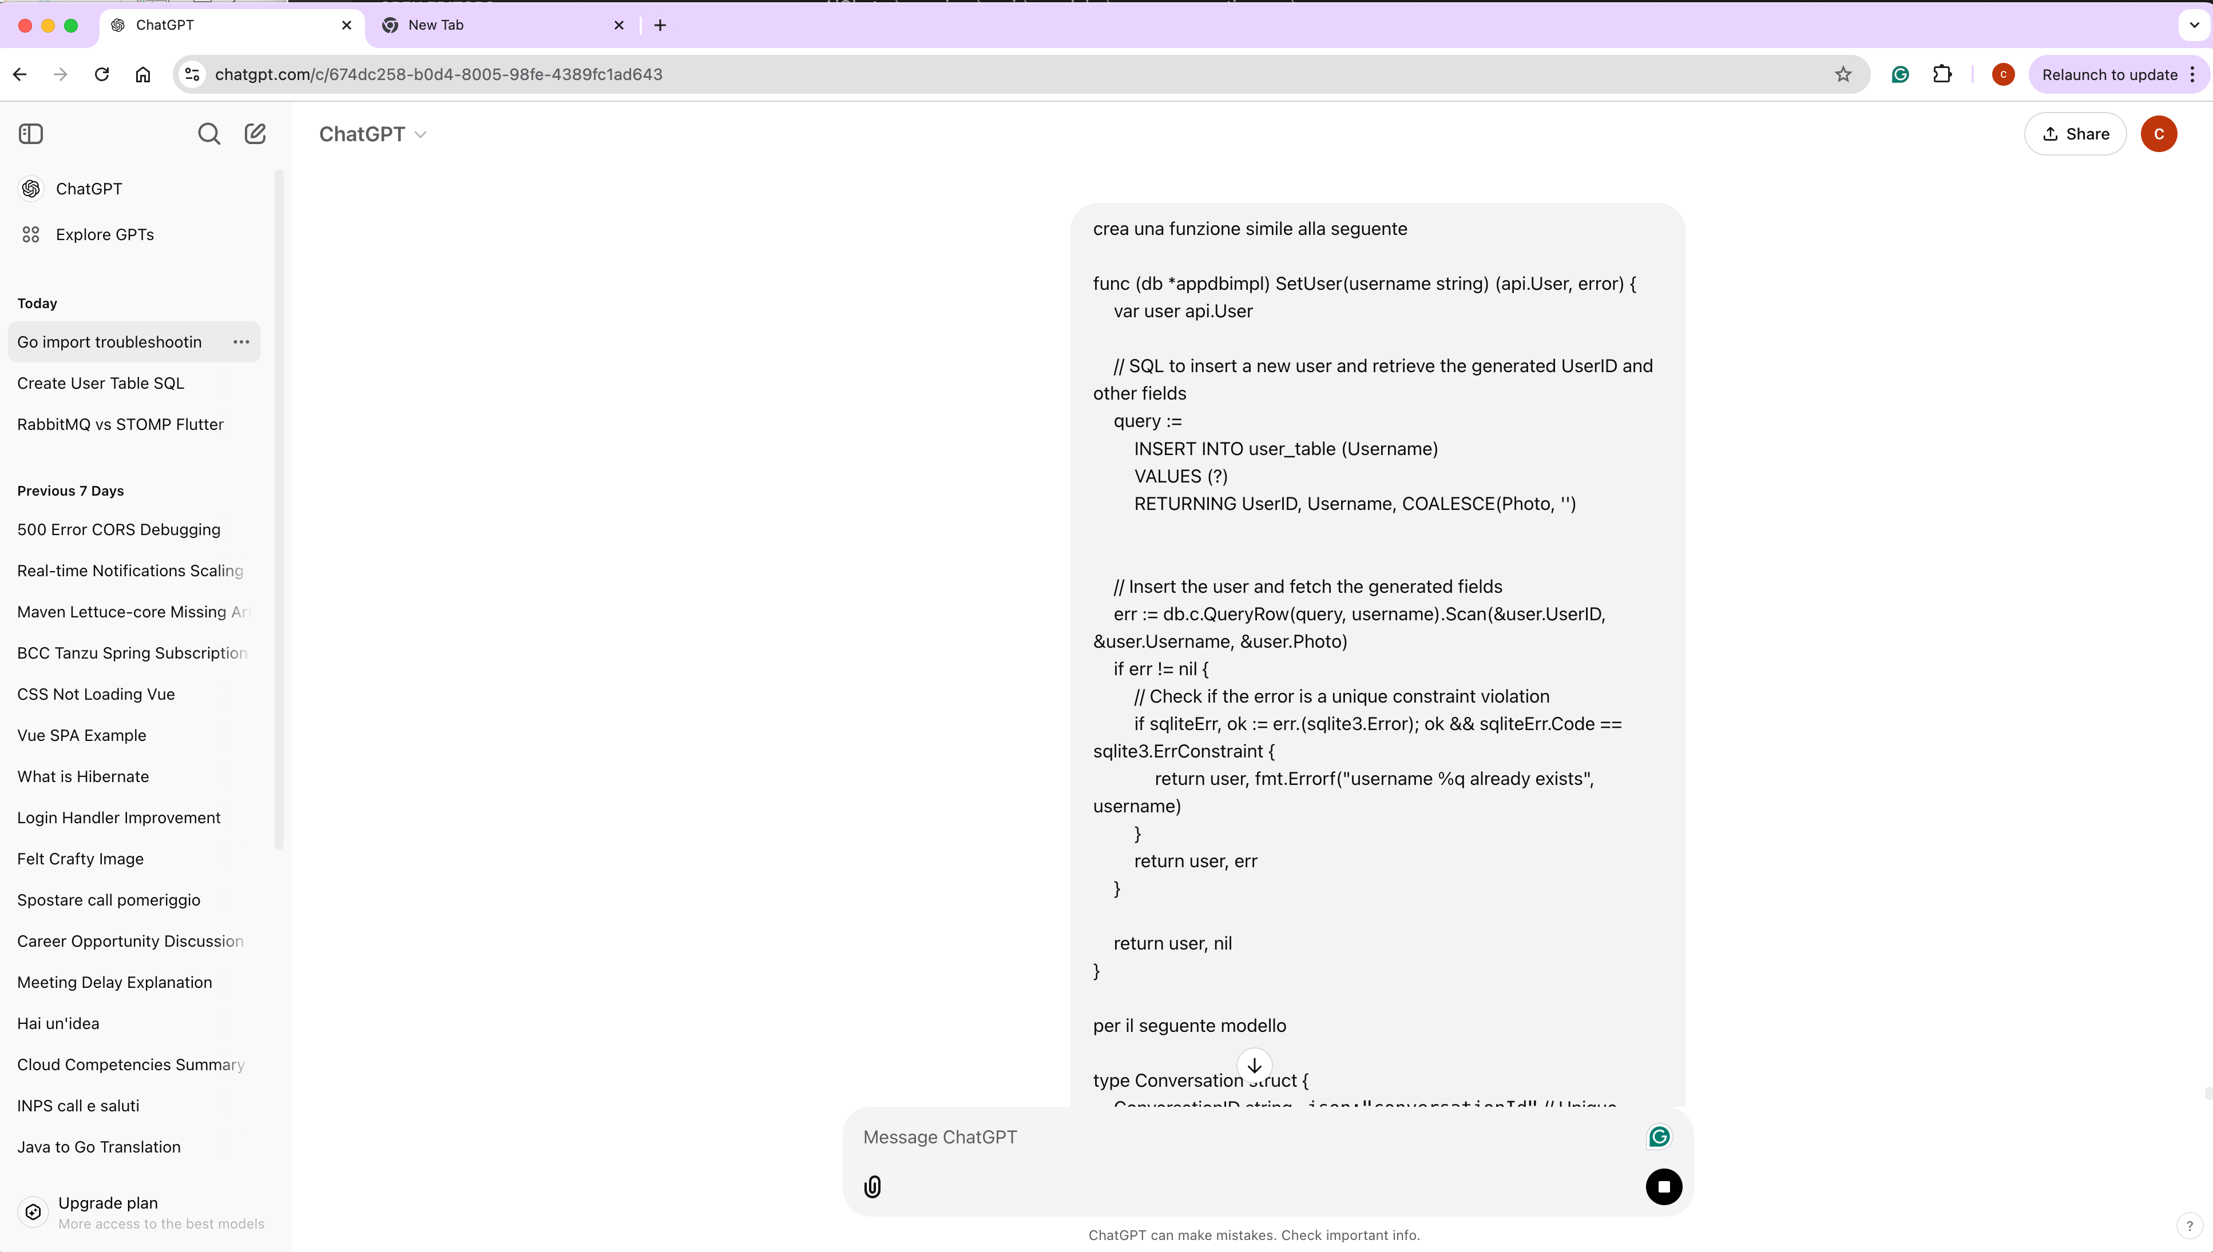
Creazione funzioni DB per Conversation
chatGPT

Slide 11
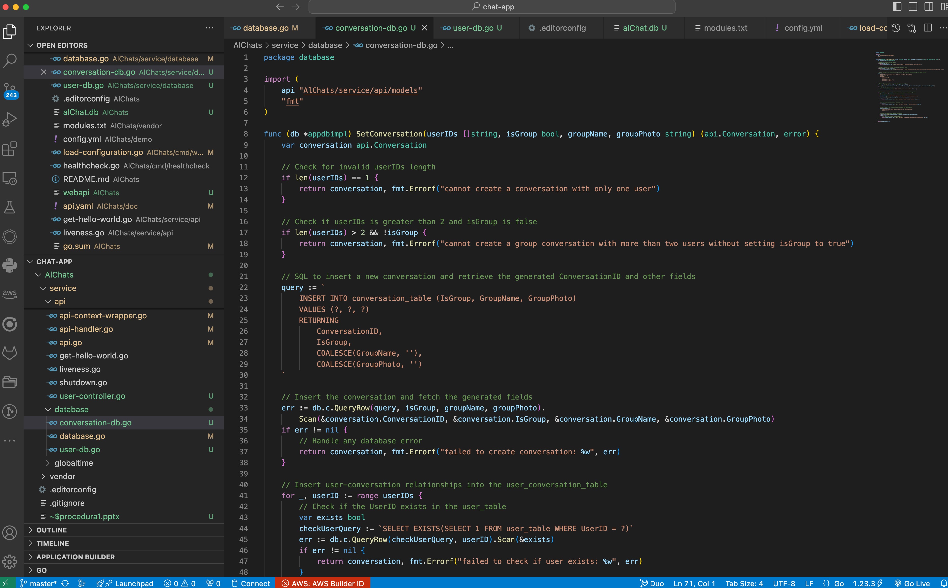
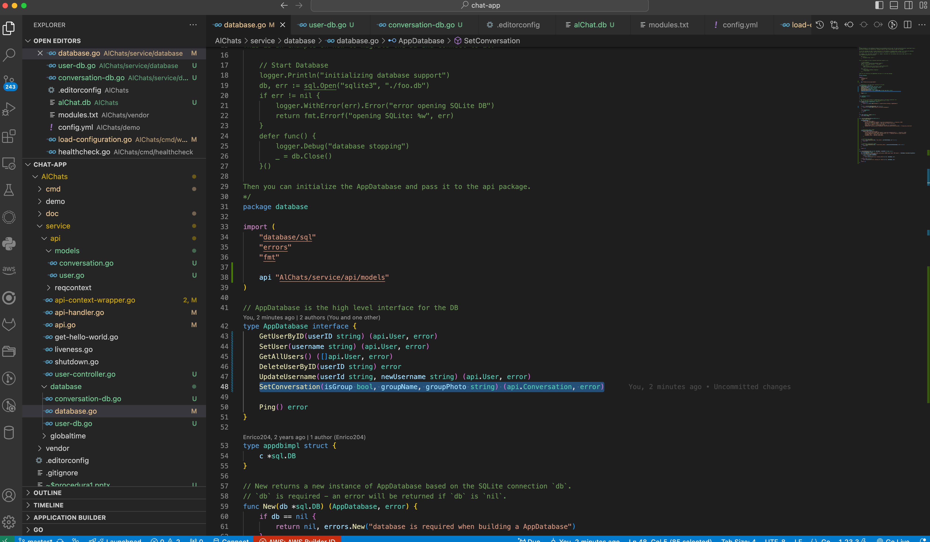
Creazione funzioni DB per Conversation
SetConversation(isGroup bool, groupName, groupPhoto string) (models.Conversation, error)

Slide 12
Creazione funzioni DB per Conversation
codice completo
verifica se gli userid passati sono giusti
(considerando group o coversazione
aggiorna tabella relazione molti-molti
dopo aver verificato che ogni utente esiste
package database
import (
api "AlChats/service/api/models"
"fmt"
)
func (db *appdbimpl) SetConversation(userIDs []string, isGroup bool, groupName, groupPhoto string) (api.Conversation, error) {
var conversation api.Conversation
// Check for invalid userIDs length
if len(userIDs) == 1 {
return conversation, fmt.Errorf("cannot create a conversation with only one user")
}
// Check if userIDs is greater than 2 and isGroup is false
if len(userIDs) > 2 && !isGroup {
return conversation, fmt.Errorf("cannot create a group conversation with more than two users without setting isGroup to true")
}
// SQL to insert a new conversation and retrieve the generated ConversationID and other fields
query := `
INSERT INTO conversation_table (IsGroup, GroupName, GroupPhoto)
VALUES (?, ?, ?)
RETURNING
ConversationID,
IsGroup,
COALESCE(GroupName, ''),
COALESCE(GroupPhoto, '')
`
// Insert the conversation and fetch the generated fields
err := db.c.QueryRow(query, isGroup, groupName, groupPhoto).
Scan(&conversation.ConversationID, &conversation.IsGroup, &conversation.GroupName, &conversation.GroupPhoto)
if err != nil {
// Handle any database error
return conversation, fmt.Errorf("failed to create conversation: %w", err)
}
// Insert user-conversation relationships into the user_conversation_table
for _, userID := range userIDs {
// Check if the UserID exists in the user_table
var exists bool
checkUserQuery := `SELECT EXISTS(SELECT 1 FROM user_table WHERE UserID = ?)`
err := db.c.QueryRow(checkUserQuery, userID).Scan(&exists)
if err != nil {
return conversation, fmt.Errorf("failed to check if user exists: %w", err)
}
// If the user does not exist, return an error
if !exists {
return conversation, fmt.Errorf("user with UserID %s does not exist", userID)
}
// SQL to insert the relationship between user and conversation
relationshipQuery := `
INSERT INTO user_conversation_table (UserID, ConversationID)
VALUES (?, ?)
`
// Insert the user-conversation relationship
_, err = db.c.Exec(relationshipQuery, userID, conversation.ConversationID)
if err != nil {
// If an error occurs, return the error
return conversation, fmt.Errorf("failed to create user-conversation relationship: %w", err)
}
}
return conversation, nil
}

Slide 13
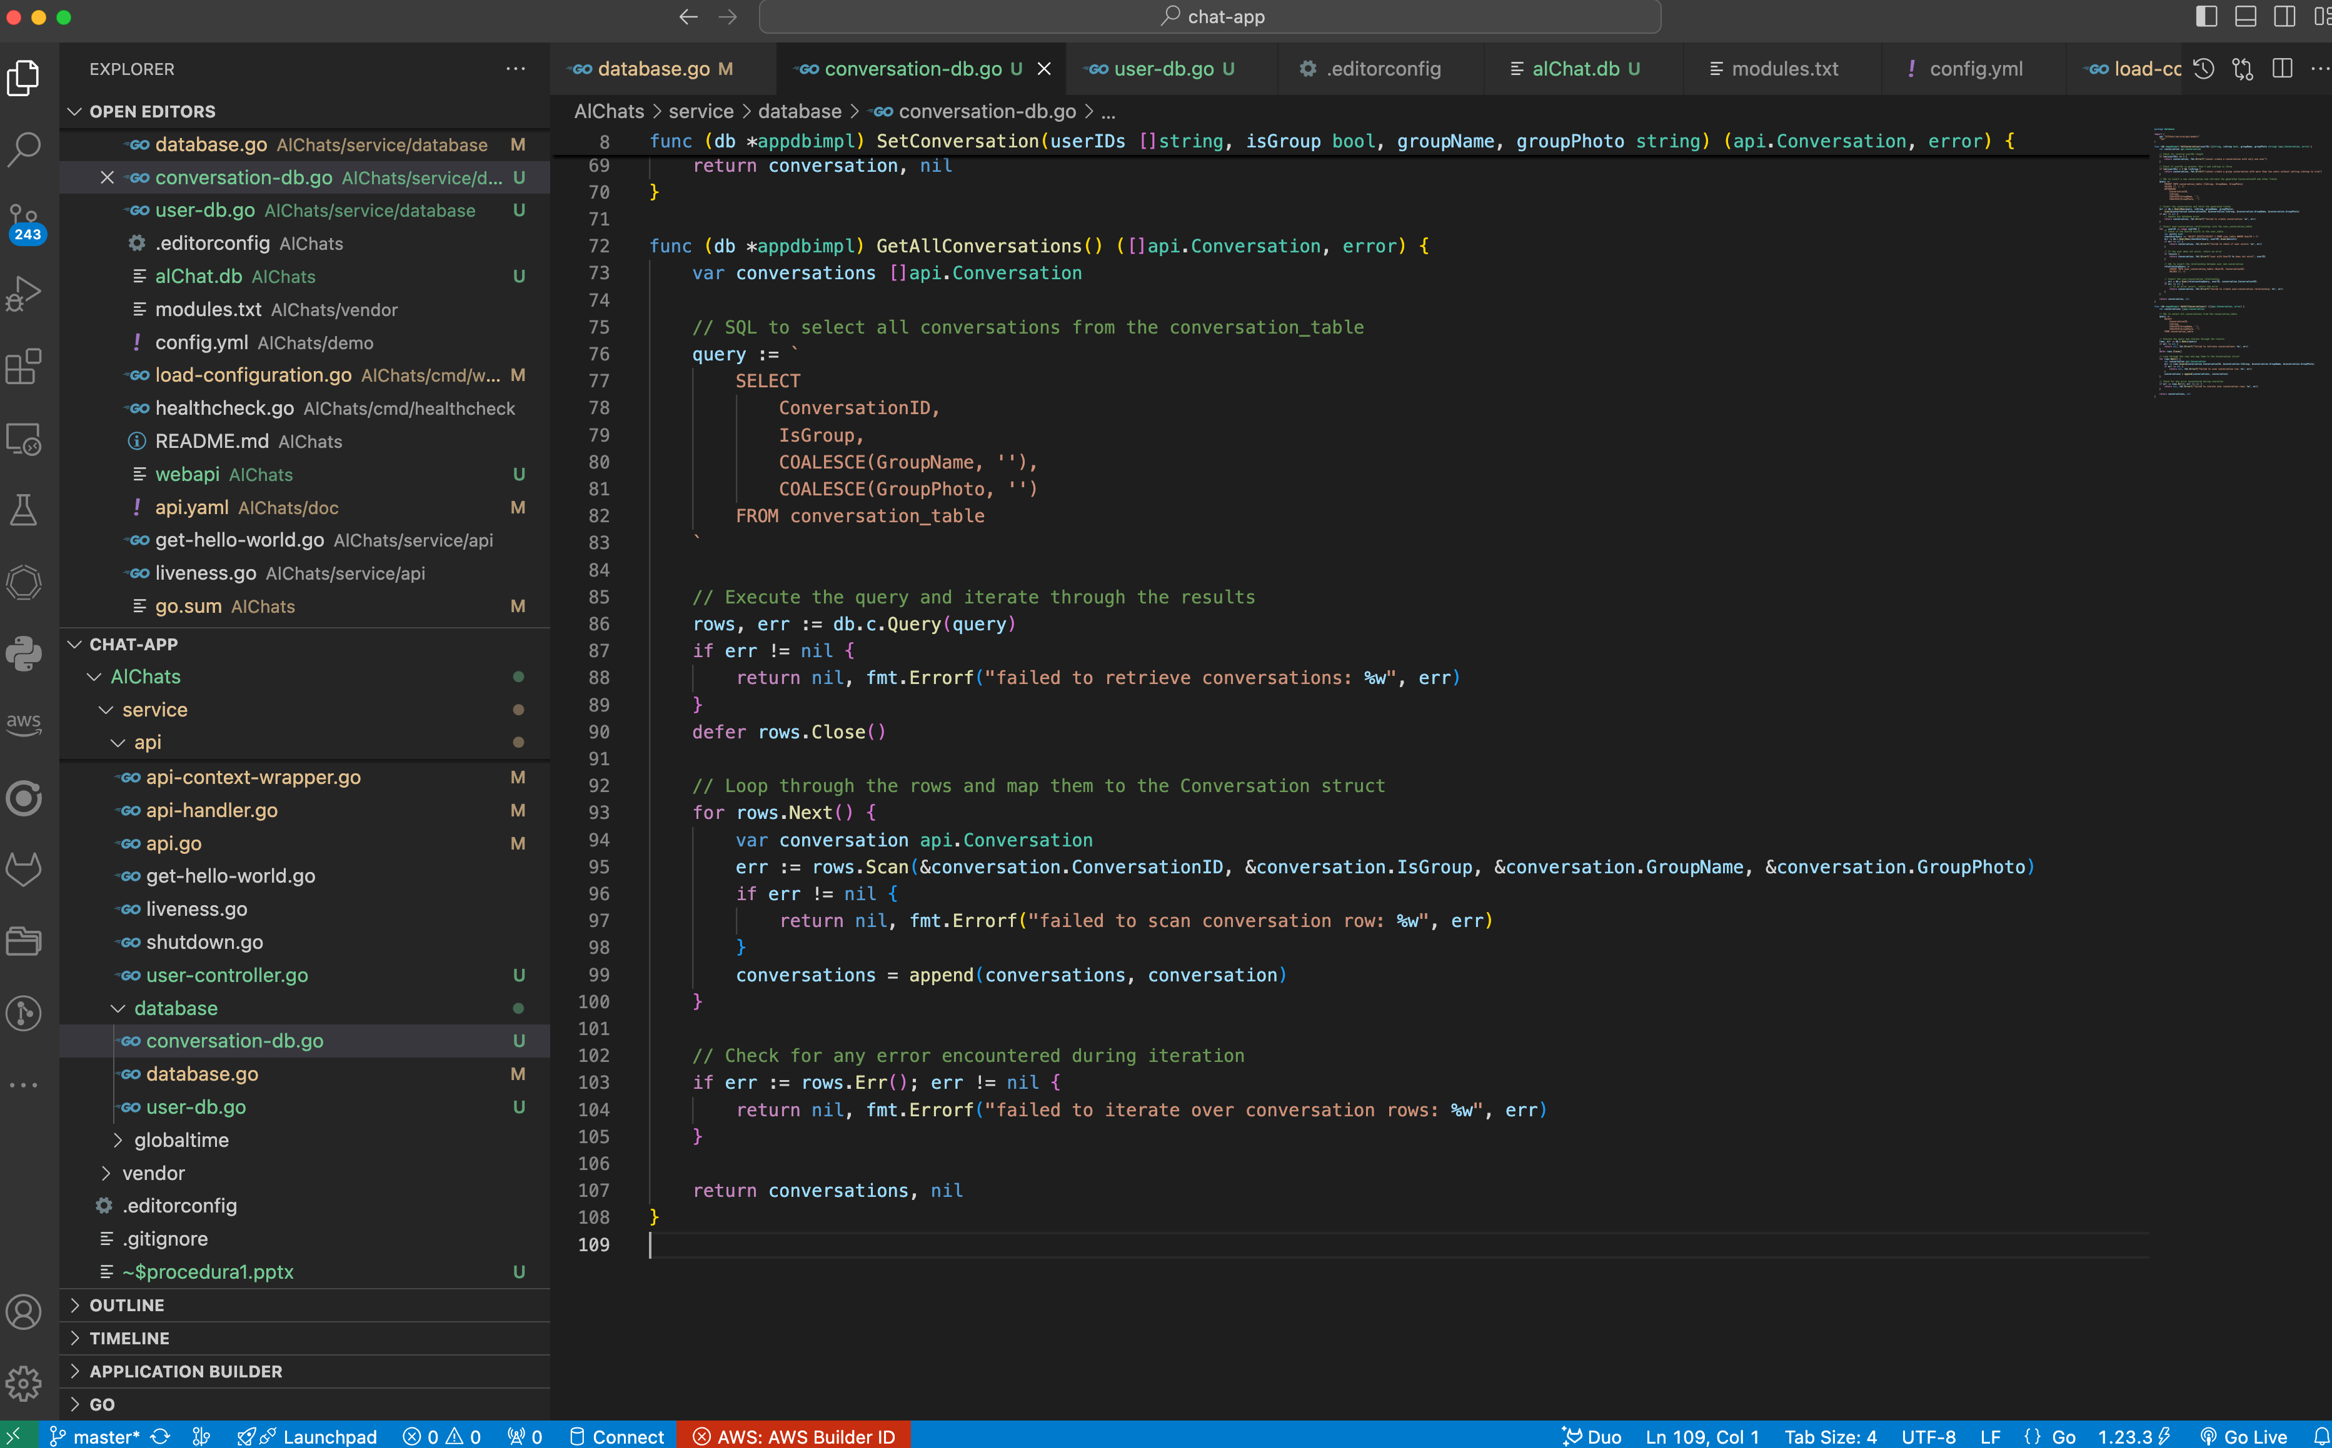
Creazione funzioni DB per Conversation
GetAllConversations() ([]api.Conversation, error)

Slide 14
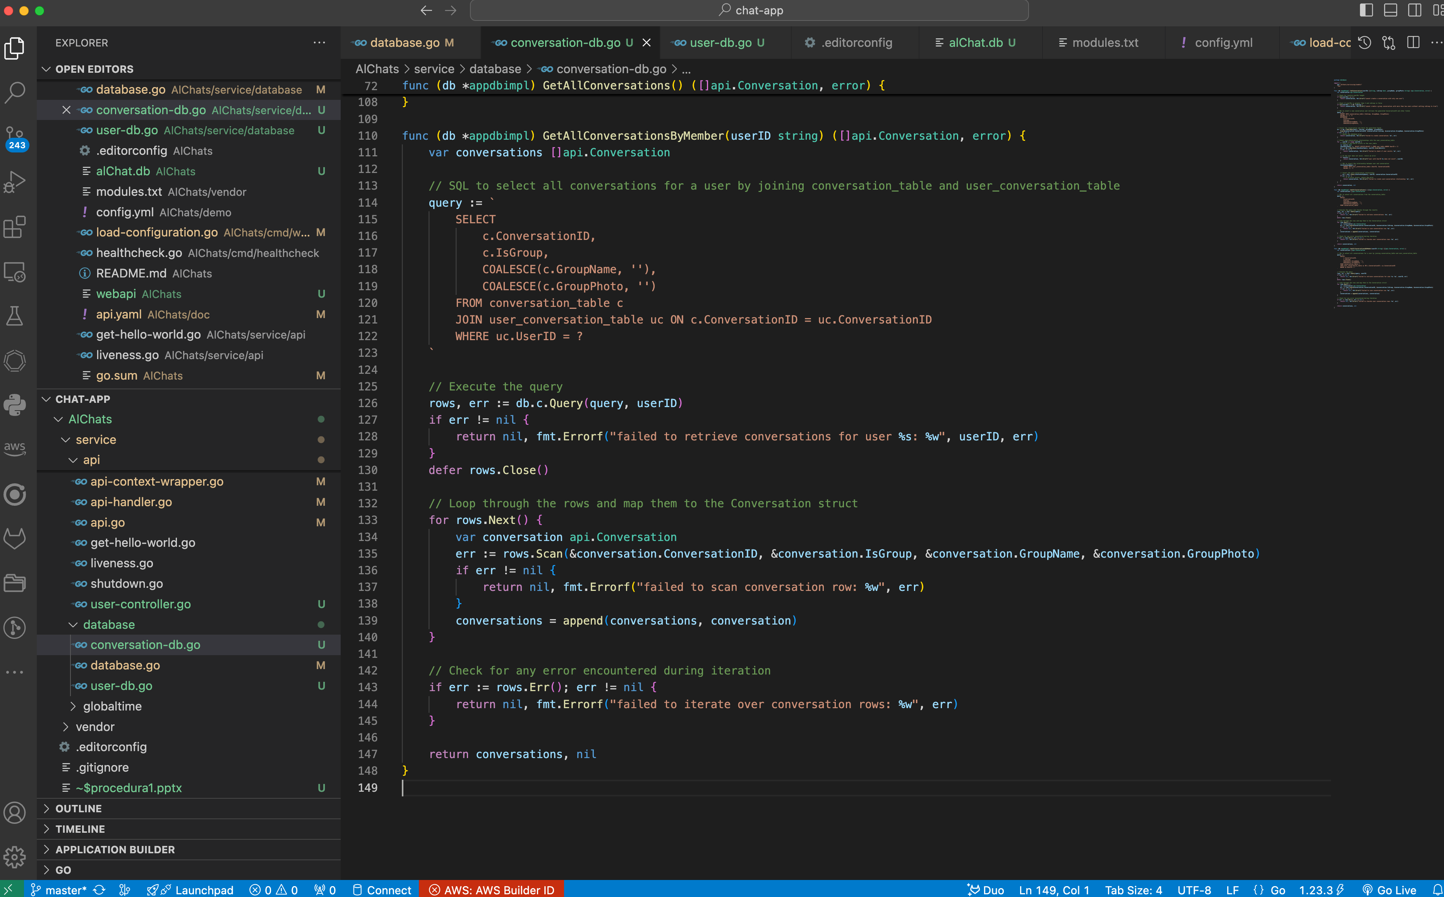
Creazione funzioni DB per Conversation
GetAllConversationsByMember(userID string) ([]api.Conversation, error)

Slide 15
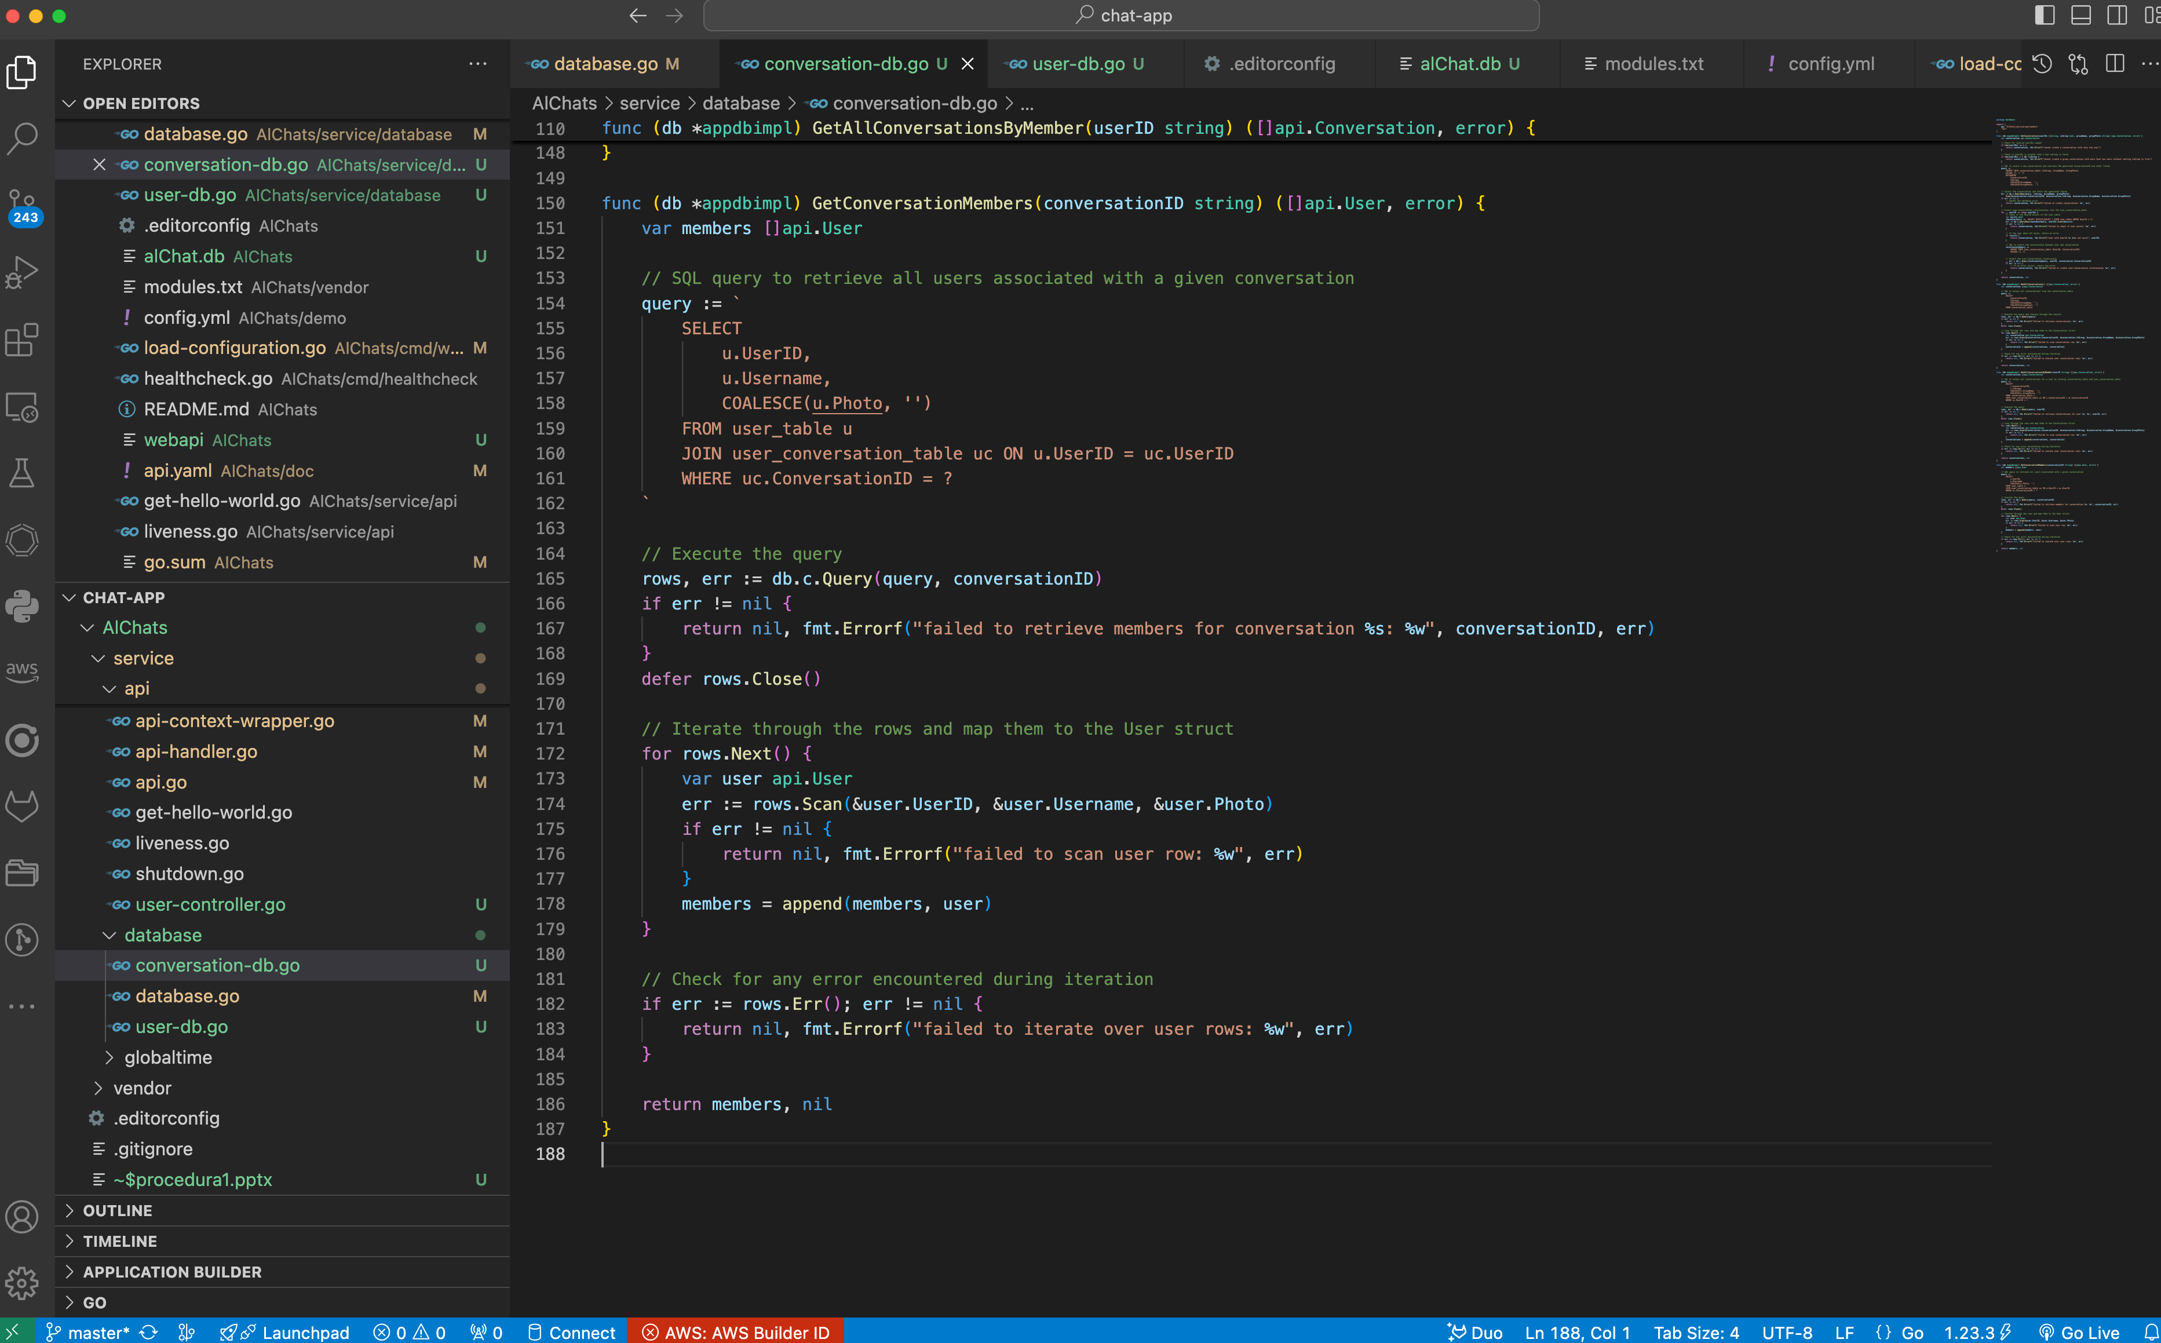
Creazione funzioni DB per Conversation
GetConversationMembers(conversationID string) ([]api.User, error)

Slide 16
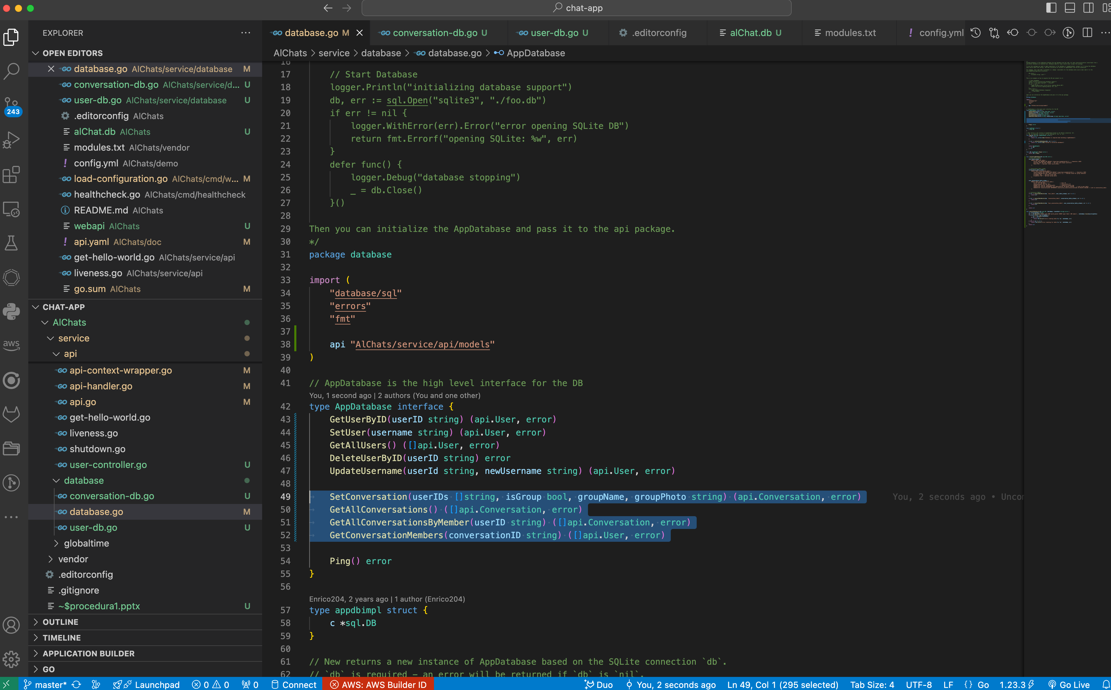
Creazione funzioni DB per Conversation
SetConversation(userIDs []string, isGroup bool, groupName, groupPhoto string) (api.Conversation, error)
GetAllConversations() ([]api.Conversation, error)
GetAllConversationsByMember(userID string) ([]api.Conversation, error)
GetConversationMembers(conversationID string) ([]api.User, error)

Slide 17
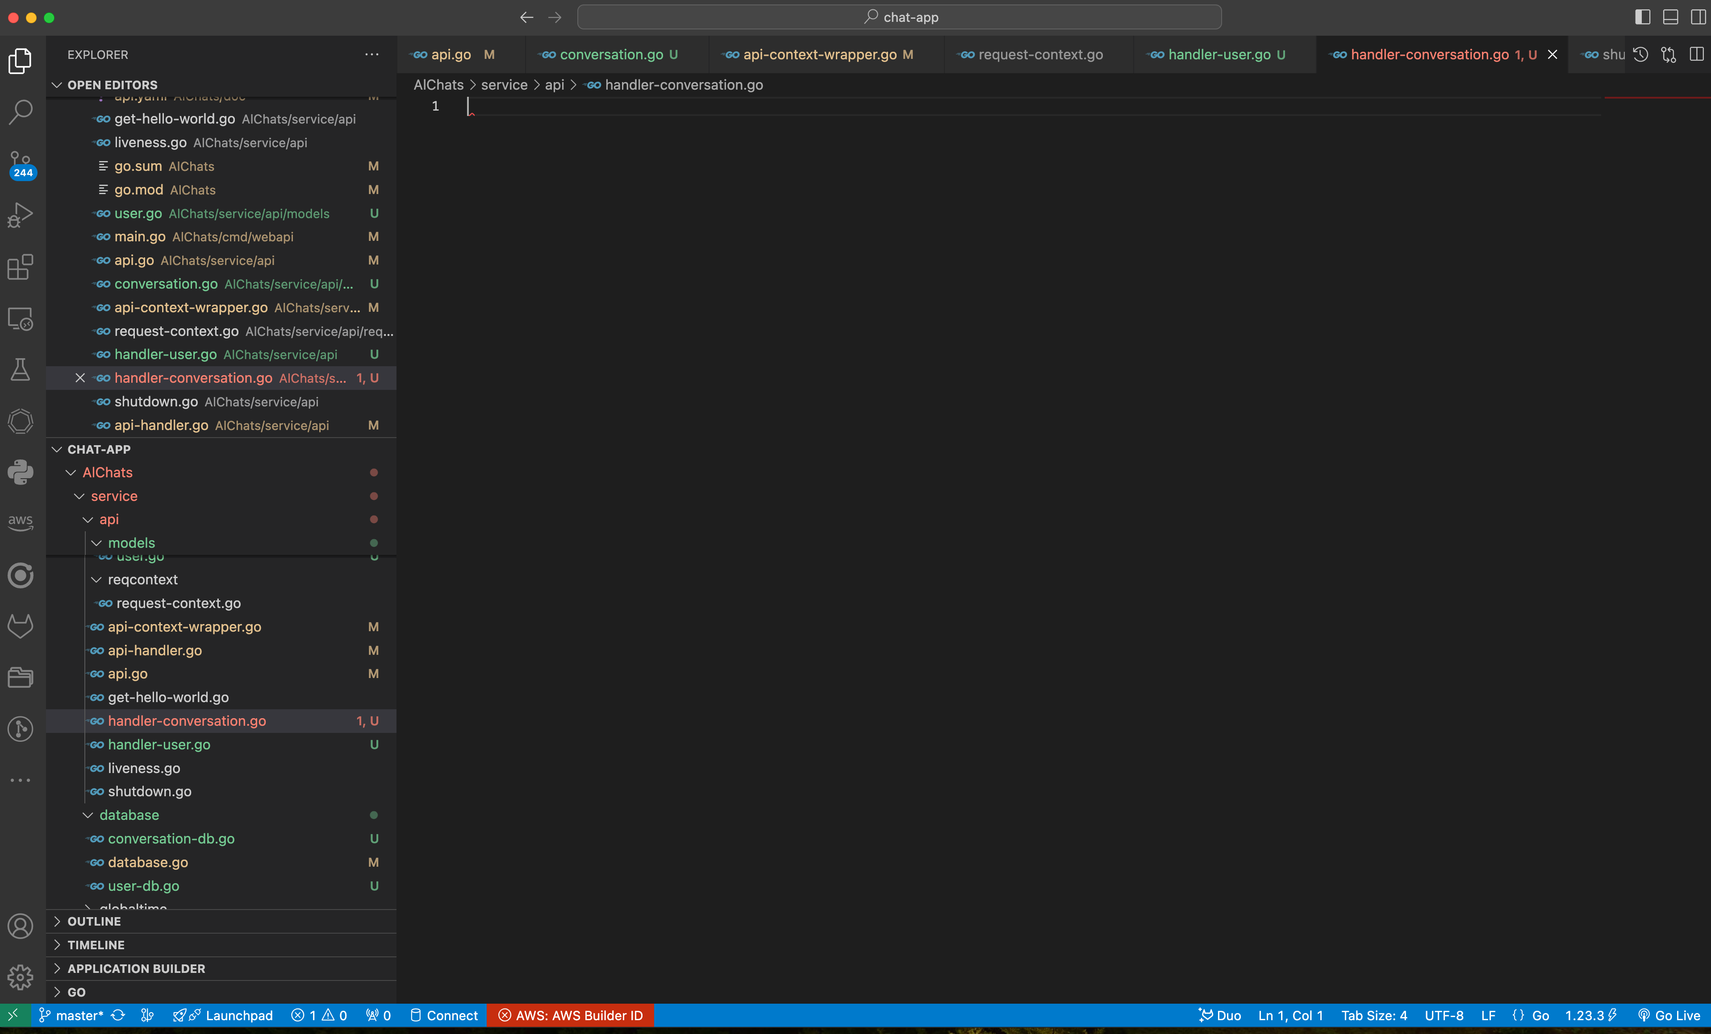
Creazione endpoint HTTP per Conversation
cambio nome dei controller in handler (handler-user ed il nuovo handler-conversation

Slide 18
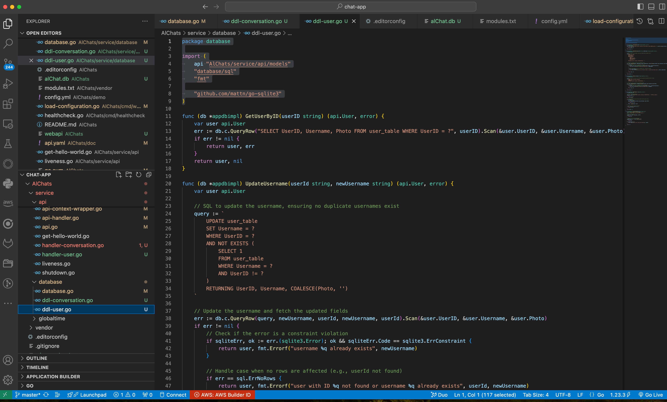
Creazione endpoint HTTP per Conversation
cambio nome anche ai file del db che contengono le query DDL (data definition language)
user-db.go diventa ddl.user.go (solo per una questione di leggibilità)

Slide 19
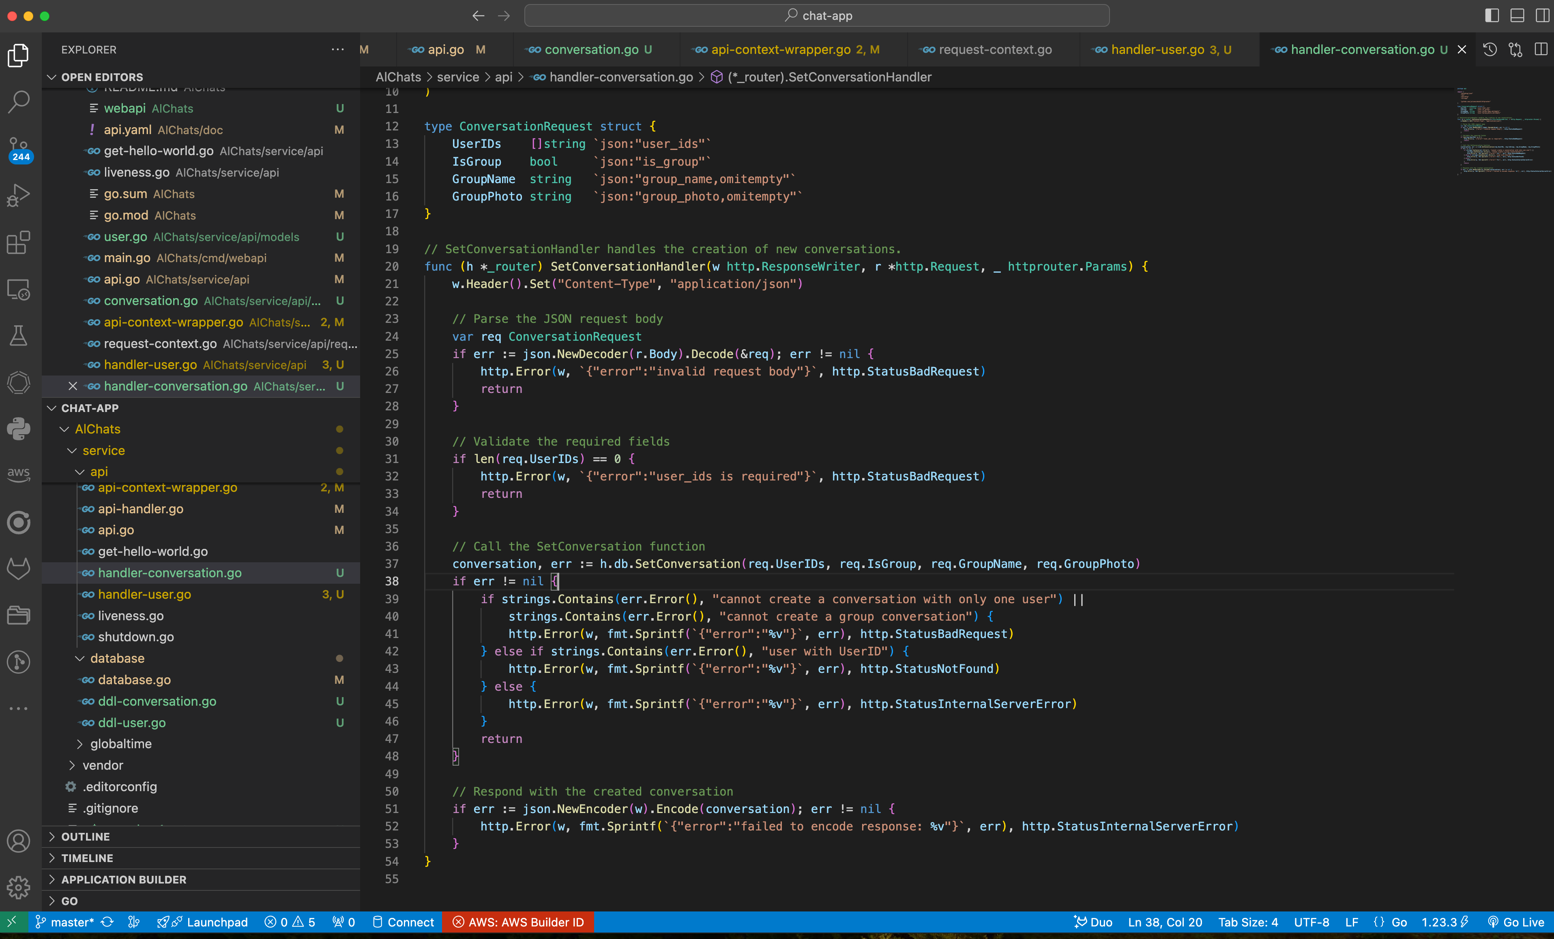
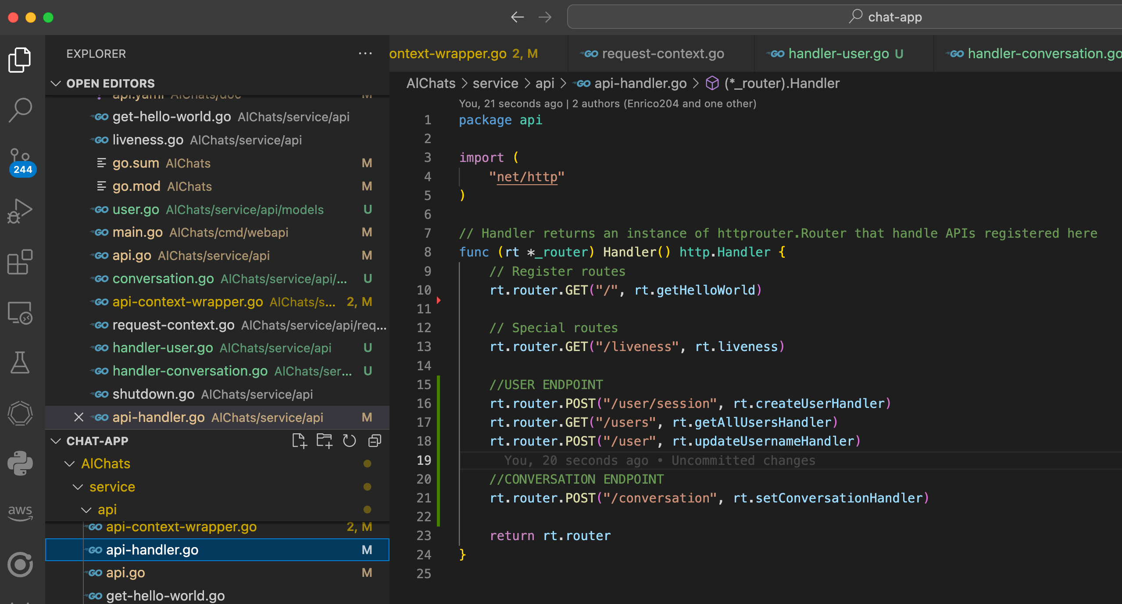
Creazione endpoint HTTP per Conversation
creo ConversationRequest che mi serve per definire il body della POST
creo il SetConversationhandler e lo dichiaro nel router
{
"user_ids": ["5eef00fcbfddfa3848b9f850e1015184", "daf495832109b2785bb525055633c4c9"],
"is_group": false,
"group_name": "",
"group_photo": "https://example.com/photo.png"
}

Slide 20
Creazione endpoint HTTP per Conversation
test endpoint
cancellazione db
pcarlo@DLJ473C2T5 chat-app % cd AlChats
pcarlo@DLJ473C2T5 AlChats % ls -al al*
-rw-r--r-- 1 pcarlo staff 16384 3 Dic 12:58 alChat.db
pcarlo@DLJ473C2T5 AlChats % rm alChat.db
pcarlo@DLJ473C2T5 AlChats % ls -al al*
zsh: no matches found: al*
pcarlo@DLJ473C2T5 AlChats %
check database
sqlite> SELECT name FROM sqlite_master WHERE type='table';
user_table
conversation_table
user_conversation_table
sqlite> select * from user_table;
sqlite> select * from conversation_table;
sqlite> select * from user_conversation_table;
sqlite>
avvio programma
pcarlo@DLJ473C2T5 AlChats % go run ./cmd/webapi/
INFO[0000] application initializing
INFO[0000] initializing database support
INFO[0000] initializing API server
INFO[0000] API listening on 0.0.0.0:3000
nessun dato

Slide 21
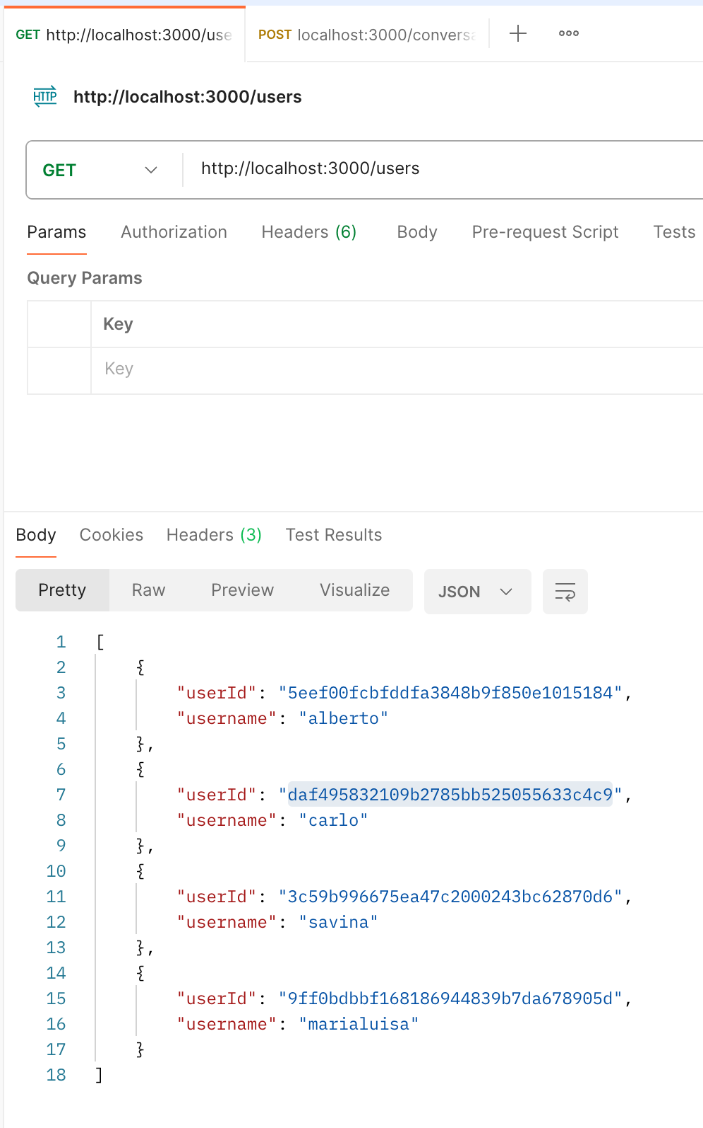
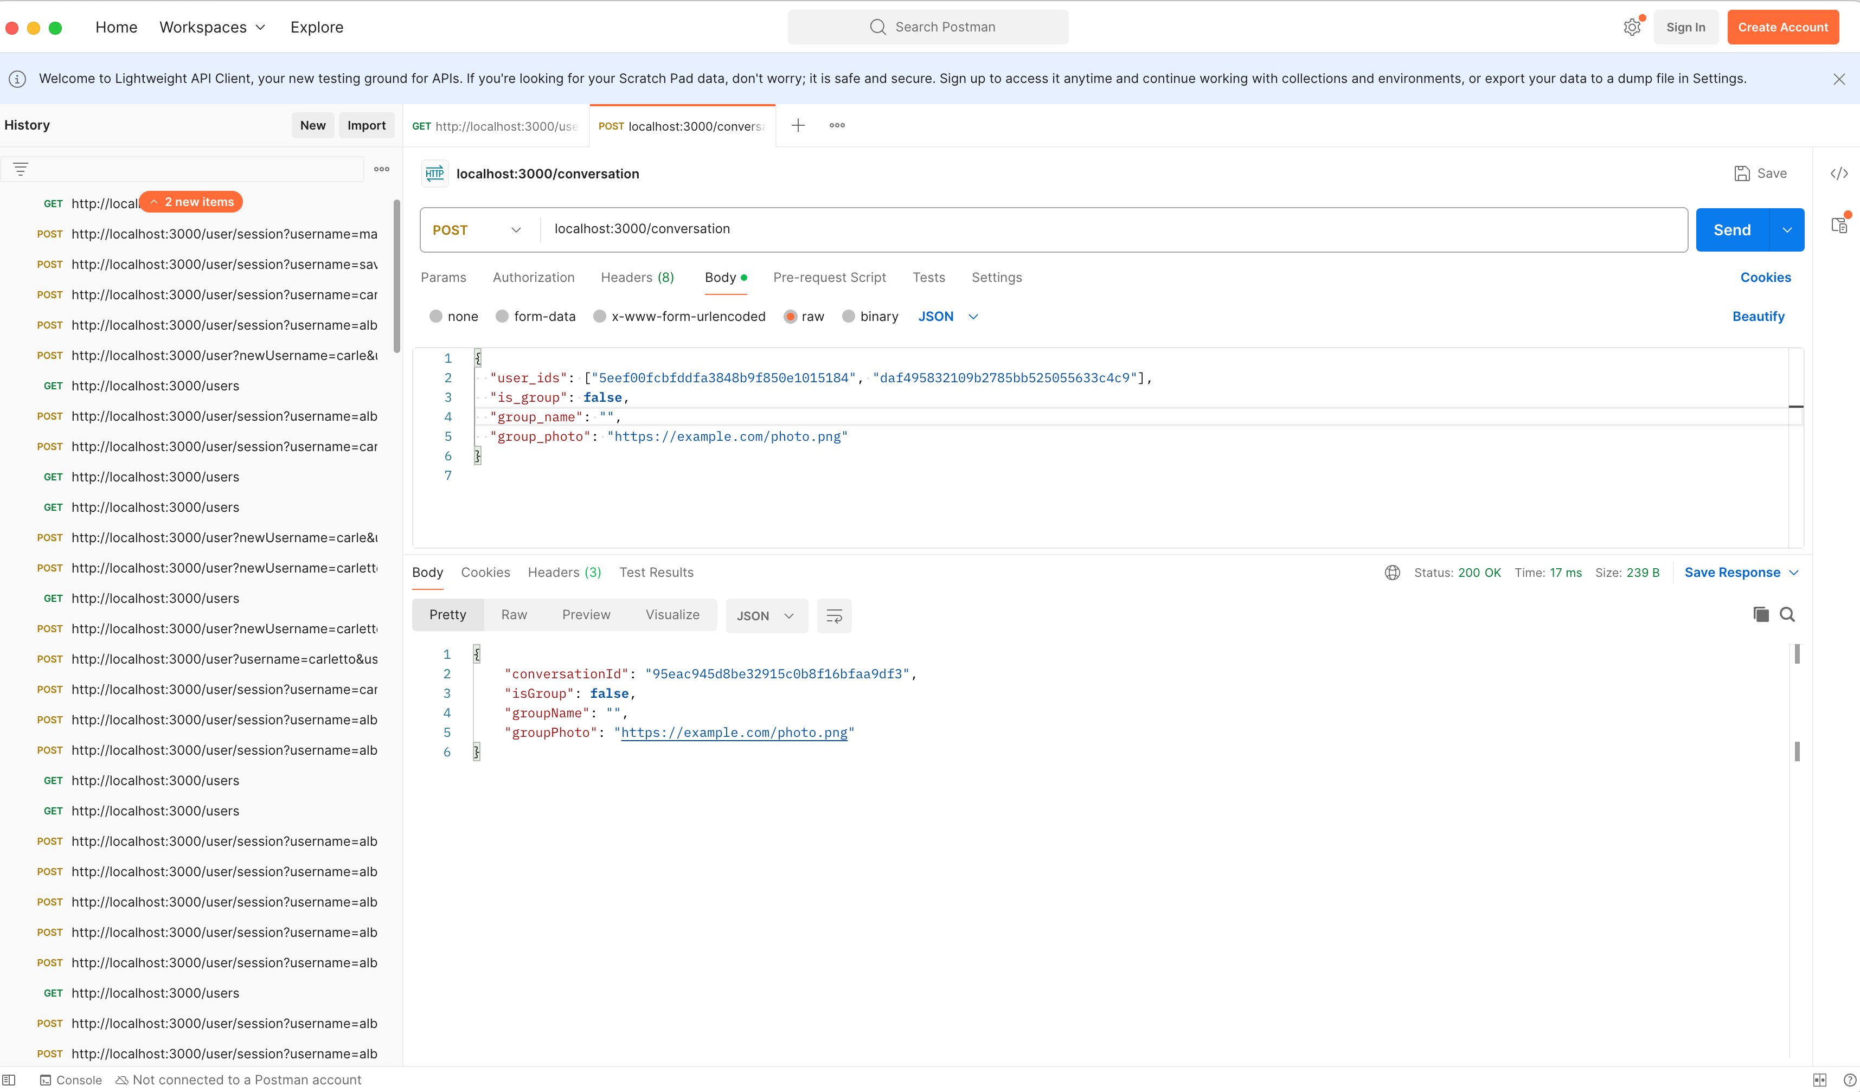

Slide 22
Creazione endpoint HTTP per Conversation
test endpoint
cancellazione db
pcarlo@DLJ473C2T5 chat-app % cd AlChats
pcarlo@DLJ473C2T5 AlChats % ls -al al*
-rw-r--r-- 1 pcarlo staff 16384 3 Dic 12:58 alChat.db
pcarlo@DLJ473C2T5 AlChats % rm alChat.db
pcarlo@DLJ473C2T5 AlChats % ls -al al*
zsh: no matches found: al*
pcarlo@DLJ473C2T5 AlChats %
avvio programma
pcarlo@DLJ473C2T5 AlChats % go run ./cmd/webapi/
INFO[0000] application initializing
INFO[0000] initializing database support
INFO[0000] initializing API server
INFO[0000] API listening on 0.0.0.0:3000
check database
sqlite> select * from user_table;
5eef00fcbfddfa3848b9f850e1015184|alberto|
daf495832109b2785bb525055633c4c9|carlo|
3c59b996675ea47c2000243bc62870d6|savina|
9ff0bdbbf168186944839b7da678905d|marialuisa|
sqlite> select * from conversation_table;
95eac945d8be32915c0b8f16bfaa9df3|0||https://example.com/photo.png
sqlite> select * from user_conversation_table;
5eef00fcbfddfa3848b9f850e1015184|95eac945d8be32915c0b8f16bfaa9df3
daf495832109b2785bb525055633c4c9|95eac945d8be32915c0b8f16bfaa9df3
sqlite>

